Slide 1
IBM University Engagement Project Submission
“Exploring the Power of Agentic AI with IBM Granite and LangFlow”

Slide 2

Project Tile – Intelligent Shopping Agent
Domain of Project – Artificial Intelligence/E-Commerce
Student Name | Recent Passport Photo | Email ID | Mobile number [WhatsApp]
Mahitha S |  | mahitha1710@gmail.com | 7338007828

Slide 3
Problem Statement -
Problem Statement : Intelligent Shopping Agent
The Challenge
Shoppers today face an overload of product options, scattered reviews, and dynamic pricing across e-commerce platforms. Finding the right product that balances price, quality, and personal preferences is time-consuming and frustrating. Traditional recommendation systems often fail to capture real-time trends, personalized needs, or contextual factors like urgency, budget, or sustainability. The challenge is not just to recommend products but to act as a smart shopping companion that helps buyers make informed and confident decisions.
The Objective
Build an agentic AI shopping assistant that provides intelligent, personalized, and real-time support. The solution should:
Fuse Multisource Data: Aggregate product details, reviews, ratings, and price comparisons across multiple e-commerce sites into unified insights.
Enable Multimodal Search: Allow users to input voice queries, images (e.g., a photo of a product), or text descriptions to find best-matching products.
Create a Predictive & Agentic Layer: Suggest purchase timing (e.g., discounts, seasonal offers), recommend alternatives, and alert users about price drops or fake reviews.
Visualize Smart Shopping Pulse: Provide a dashboard summarizing comparisons, sustainability scores, trending products, and personalized shopping lists.

Slide 4
Technology Used
Tech Stack (Mandatory)
Use any one of the following approaches:
LangFlow + IBM watsonx.ai + Granite Models
IBM Cloud Agentic Lab with IBM Granite Models
Replicate with LangChain + RAG + IBM Granite Models
I used LangFlow + IBM watsonx.ai + Granite Models

Slide 5
Proposed Solution -
Proposed Solution: Intelligent Shopping Agent
The proposed solution is a multi-agent AI-powered Intelligent Shopping Assistant built using LangFlow, IBM watsonx.ai, and Granite Models to provide personalized, real-time shopping guidance. The system addresses challenges such as product overload, scattered reviews, dynamic pricing, and difficulty in finding the best products across multiple e-commerce platforms.
At its core, the solution uses a Retrieval-Augmented Generation (RAG) pipeline to collect and process product details, ratings, customer reviews, discounts, and price comparisons from trusted online shopping platforms. This information is embedded and stored in a vector database, enabling the system to retrieve and summarize product insights intelligently using Granite models.
The system consists of four key agents:
Product Knowledge Agent retrieves and summarizes product information, specifications, reviews, and ratings using RAG.
Recommendation Agent generates personalized product suggestions based on user preferences such as budget, brand interests, shopping behavior, and ratings.
Smart Price & Trend Agent predicts price drops, tracks seasonal offers, detects fake reviews, and recommends better alternatives for smarter purchasing decisions.
Multimodal Search Agent allows users to search products through text, voice, or image inputs and finds the best-matching products instantly.
LangFlow is used to orchestrate agent workflows, while watsonx.ai ensures scalable AI model deployment, embeddings, and governance. Granite models power reasoning, summarization, personalization, and recommendation generation.
Overall, this solution delivers an end-to-end intelligent shopping assistant that acts as a smart shopping companion, helping users save time, compare products efficiently, and make confident purchasing decisions through personalized insights and real-time recommendations.

Slide 6
Langflow component Used -
1) Chat Input – Interface where users enter their queries, preferences, or meal details (text/voice/image).
2) IBM watsonx AI Agent - Processes user input using Granite models to generate personalized nutrition insights and recommendations.
3) Name of IBM Granite model - Granite-4.0-8B-Instruct → Fast, efficient for real-time diet recommendations
4) Chat output -Displays AI-generated responses such as diet plans, nutritional analysis, and health suggestions.
5) File Component - Stores and retrieves product details, customer reviews, price comparison data, and user preferences for personalized shopping analysis and recommendations.

Slide 7
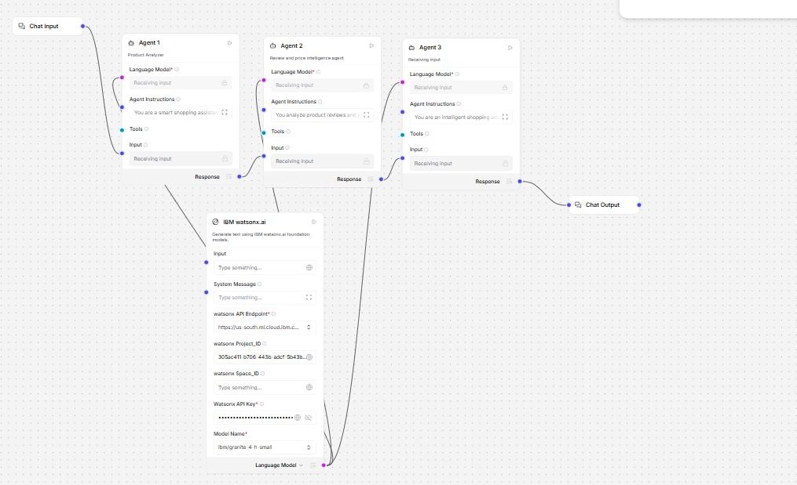
Langflow workflow -

Slide 8
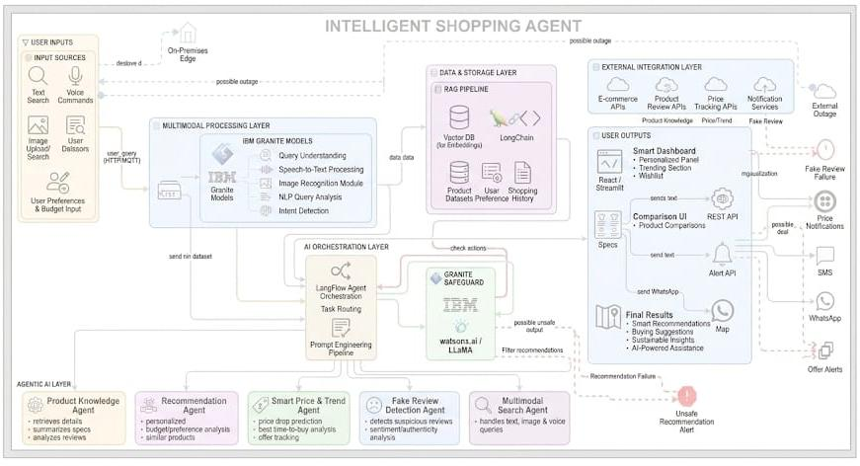
Architecture blueprint

Slide 9
Role of Agentic AI in the solution
Role of Agentic AI in Intelligent Shopping Agent
Agentic AI enables the Intelligent Shopping Agent to function as an autonomous and intelligent shopping assistant rather than a basic recommendation system. Using IBM watsonx.ai and IBM Granite models, it coordinates multiple specialized agents to provide personalized and real-time shopping guidance.
Each agent performs a specific role such as retrieving product information, comparing prices, analyzing customer reviews, predicting price drops, and generating personalized recommendations. This multi-agent approach ensures efficient task execution and accurate shopping insights.
Agentic AI also provides context awareness, understanding user preferences such as budget, product interests, ratings, and shopping behavior to generate tailored recommendations. It supports real-time adaptation, continuously updating suggestions based on current offers, trending products, and user interactions.
Additionally, agents communicate with each other to improve decision-making, detect fake reviews, recommend better alternatives, and provide smarter purchasing strategies.
Overall, Agentic AI makes the system proactive, personalized, and goal-driven, acting like a smart digital shopping companion that helps users make confident and informed buying decisions..

Slide 10
Technology Used
Langflow platform -For designing and orchestrating multi-agent workflows visually
IBM Grainte model - for eg – ibm-granite-3-2-8b – For natural language understanding, reasoning, and personalization
IBM Cloud – It provides the infrastructure to build, deploy, and scale the Nutrition Agent efficiently. IBM Cloud enables a reliable, secure, and scalable environment for deploying the Nutrition Agent.
RAG– RAG to fetch real data first, then generate intelligent answers, making the Nutrition Agent more trustworthy and effective.
IBM Watsonx.ai - For model deployment, embeddings, and AI governance
Vector Database (FAISS/Chroma) – For RAG-based nutritional data retrieval

Slide 11
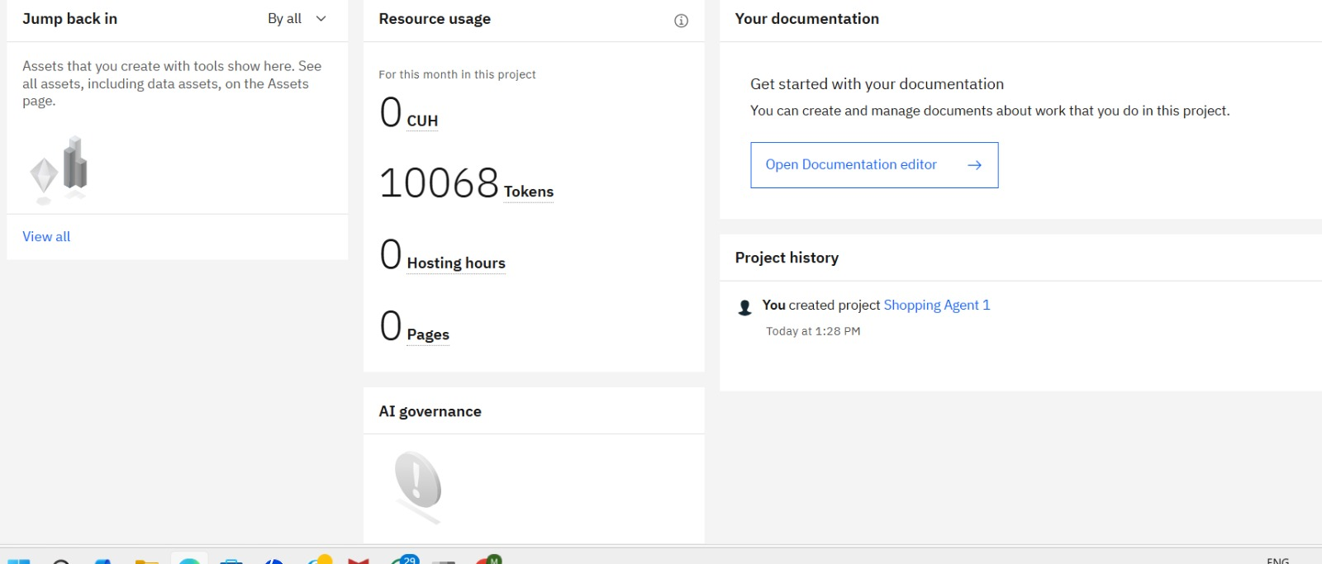
Token Usage
11,761 token are used
·
·
·

Slide 12
Novelty and Uniqueness
The proposed Intelligent Shopping Agent stands out by combining Agentic AI, RAG, multimodal search, and hyper-personalized recommendations into a single smart shopping ecosystem.
Multi-Agent Intelligence - Instead of a traditional chatbot, multiple specialized AI agents collaborate to analyze products, reviews, prices, and shopping trends for accurate decision-making.
RAG-Based Product Understanding - Integrates real-time product retrieval with AI-generated insights, ensuring reliable recommendations from updated product data, ratings, and customer reviews.
Hyper-Personalization - Tailors product suggestions based on user preferences, budget, shopping behavior, brand interests, and purchase history.
Real-Time Smart Shopping Assistance - Continuously tracks discounts, seasonal offers, trending products, and price drops to help users buy products at the best time and price.
Multimodal Input Support - Supports text, voice, and image-based product searches for a seamless and user-friendly shopping experience.
Fake Review Detection & Better Alternatives - Uses AI reasoning to identify suspicious reviews and recommend better-value alternative products.
Scalable & Enterprise-Ready Architecture - Built on IBM watsonx.ai with IBM Granite models and LangFlow, ensuring scalability, reliability, and AI governance.
This makes the solution a smart, adaptive, and proactive AI shopping companion, not just a basic product recommendation system.

Slide 13
Git Hub Link
https://github.com/mahitha5417/Shopping-Agent-1
·
·
·

Slide 14
Future Scope
1. AI-Powered Virtual Shopping Assistant – The system can be enhanced with a conversational voice-enabled shopping assistant that interacts naturally with users, understands preferences in real time, and provides personalized product suggestions through voice commands and multilingual support.
2. Integration with AR/VR Shopping Experience – Future versions can integrate Augmented Reality (AR) and Virtual Reality (VR) technologies to allow users to virtually try products such as clothes, accessories, furniture, or cosmetics before purchasing, improving online shopping confidence.
3. Real-Time Personalized Deal Prediction – The platform can be upgraded with advanced predictive analytics to forecast future discounts, festive sales, and price drops based on historical shopping trends and market behavior
4. Smart Cross-Platform Shopping Integration – The solution can be connected with multiple e-commerce platforms to provide unified shopping comparisons, synchronized wishlists, and centralized order tracking across different applications.
·
·
·

Slide 15


